Slide 1

INTEGRATED FUZZY MULTICRITERIA DECISION MODEL FOR CLOUD SERVICE SELECTION AND COMPONENT SERVICE IMPORTANCE EVALUATION
Winner of the best Doctoral research award: FLINS 2016, France

Slide 2

RESEARCH Background
The competitive cloud computing market resulted in a large number of Functionally similar cloud services available over the internet. With the proliferation of services, efficient and accurate service selection based on user-specific requirements has become a significant challenge for decision makers and Cloud consumers (Sun, 2016; Qu Lie, 2015). Selection of the best candidate services among them, is not a straightforward task due to the influence of several non-functional characteristics (Garg, Versteeg, & Buyya, 2013).
Numerous studies have explored this problem in several different ways including MCDM-based, optimization-based, Service description & logic-based, QoS prediction, recommendation systems, reputation mechanisms, etc. (Ma et al., 2016; L. Sun et al., 2014).

Slide 3
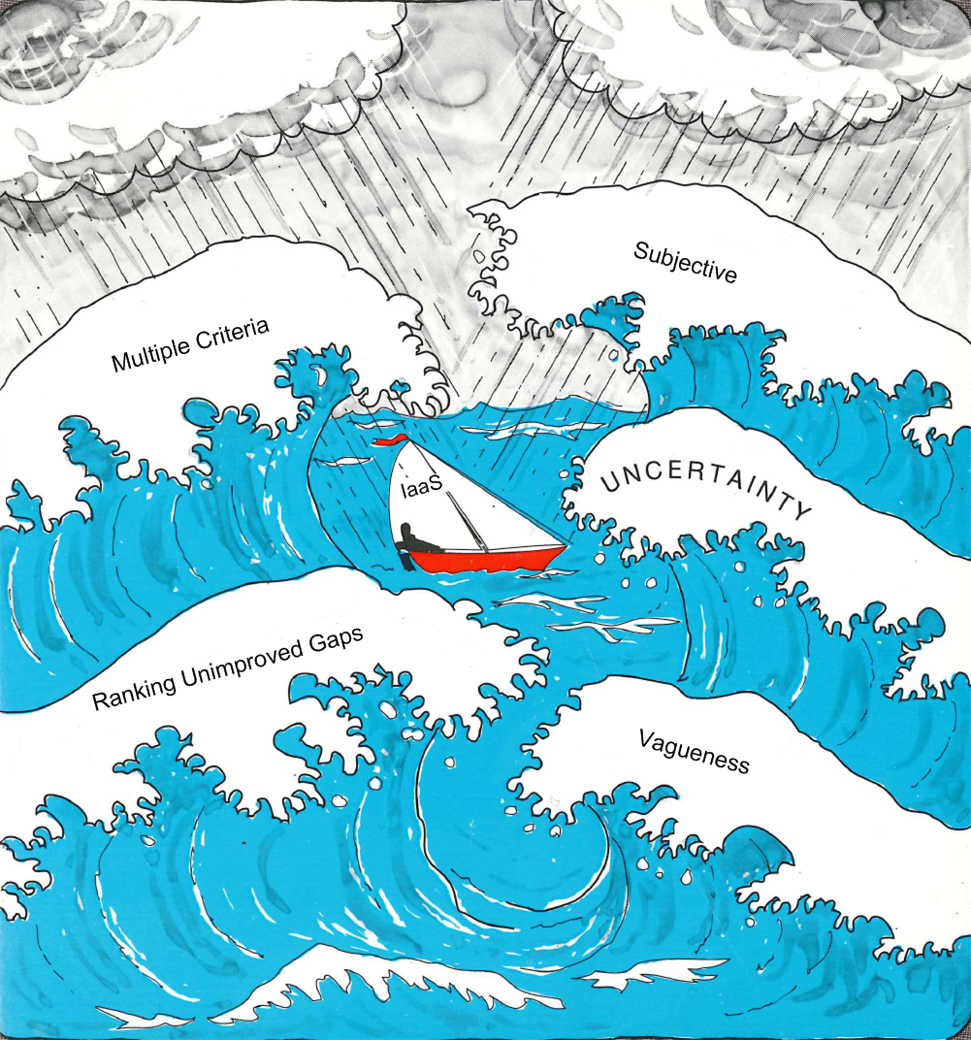
WHY Fuzzy MCDM
While evaluating cloud services, decision maker’s past experiences and perceptions are incomplete and imprecise, which can be described as fuzzy perceptions. According to (Zadeh, 1975; Klir & Yan, 1995; Lu, Zhang & Ruan, 2007; Tzeng & Huang, 2011) fuzzy set theory aids in measuring the ambiguity of concepts that are associated with human being’s subjective judgment. It can provide a powerful tool called linguistic variables to efficiency modelling the vagueness or fuzziness inherently existing in the decision-making problems.

Slide 4
RESEARCH PROBLEM
The plethora of service providers with a range of functionally similar cloud services makes it difficult for the user to select the most appropriate and optimal cloud service.
General Problem
little discussion on aggregation of subjective user feedback and objective performance assessments.
Focus on certain type of evaluation criteria for decision making. non-consideration of several critical factors (Geographical coverage, maturity, compliance, price/perform. ratio etc).
Inherent uncertainty & fuzziness in subjective opinions.
The issue of evaluation method uncertainty is unaddressed yet.
Lack of consideration of state-of-the-Art MCDM algorithms (MMOORA, WASPAS, VIKOR , COPRAS) and availability of tools.
Research gaps
Core Problem
There is a need of systematic procedure aggregating the user feedback and real-world performance assessment data, while incorporating the uncertainty and vagueness at multiple levels.
(Qu Lie, Wang Yan, Orgun Mehmet A,. Liu Ling, Liu Huan, 2015), (Garg, Versteeg, & Buyya, 2013), (Lee & Seo, 2015), (R. R. Kumar, Mishra, & Kumar, 2017)

Slide 5
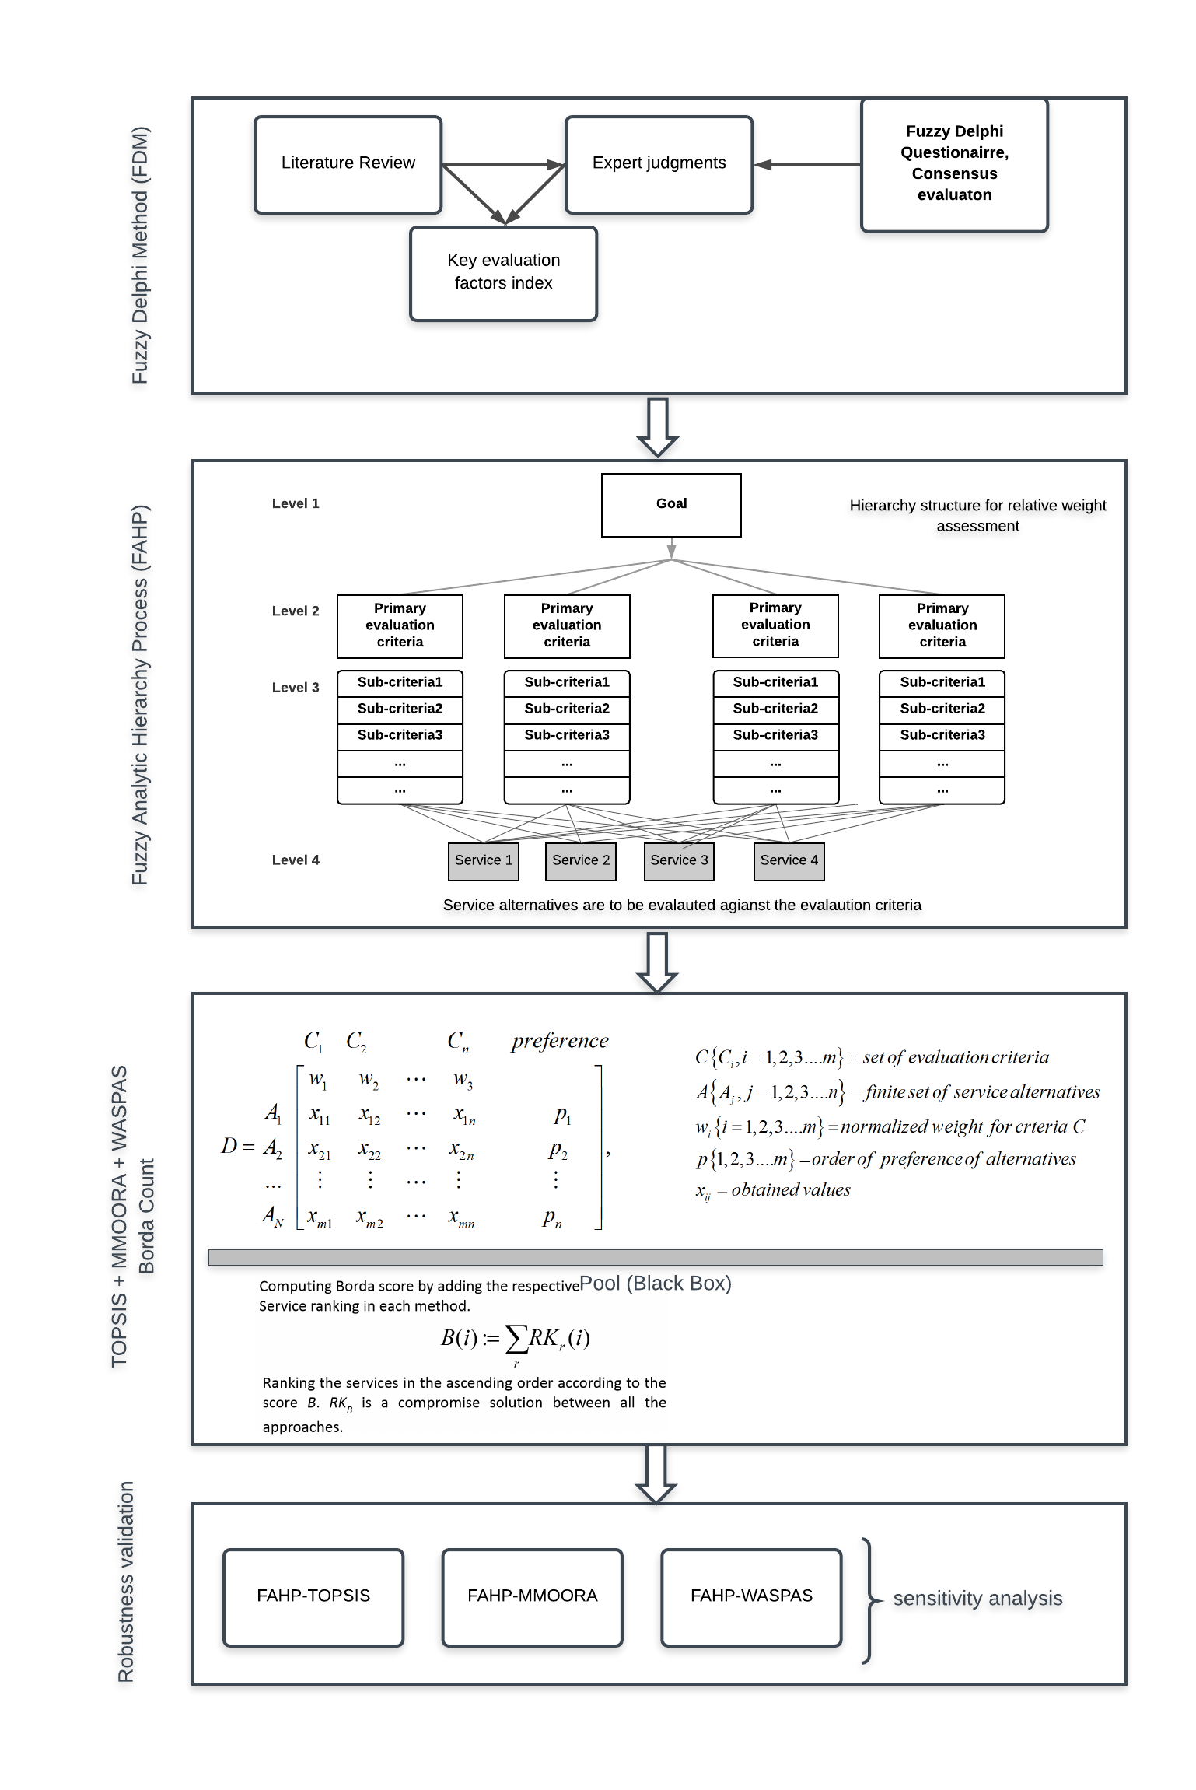

Slide 6
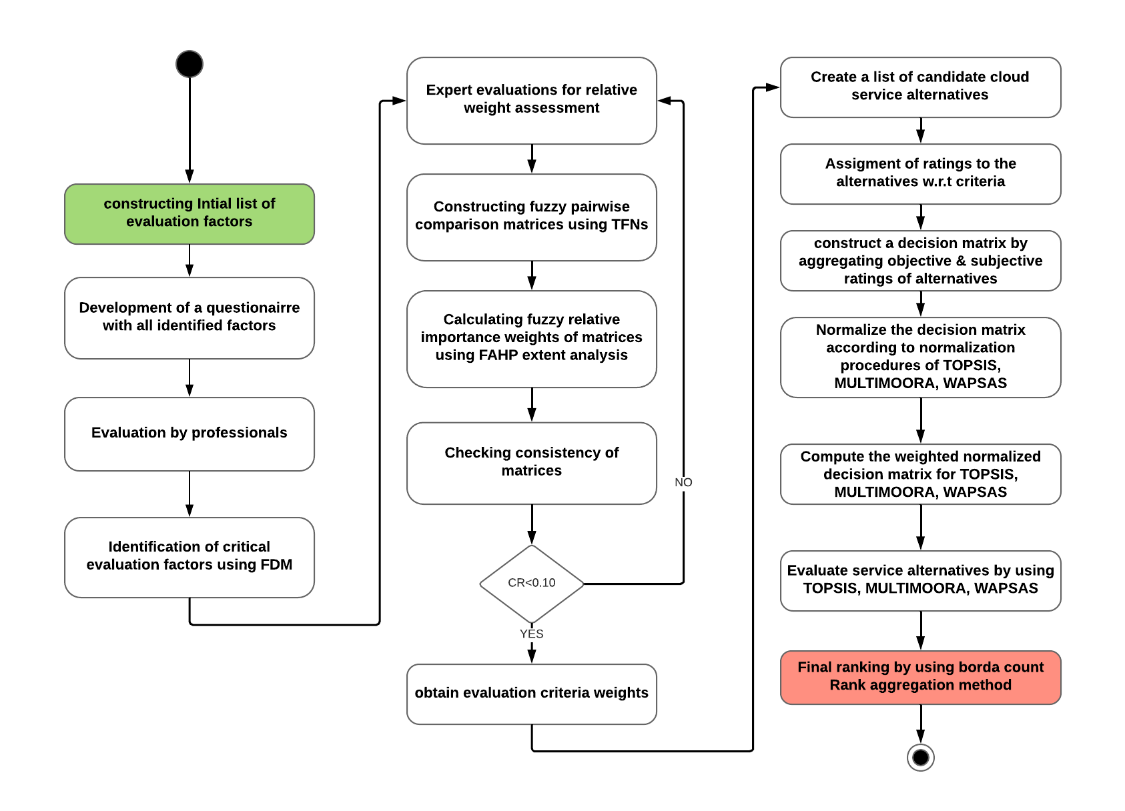

Slide 7
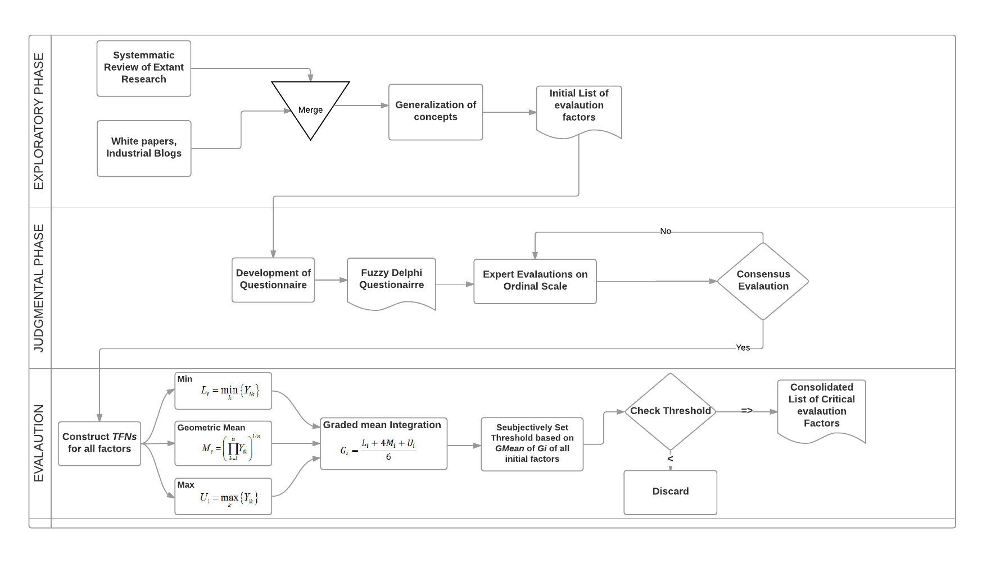

Slide 8
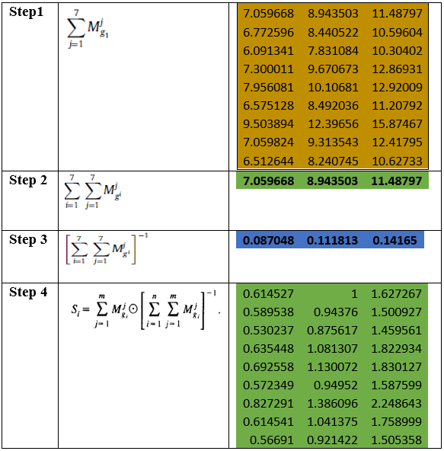
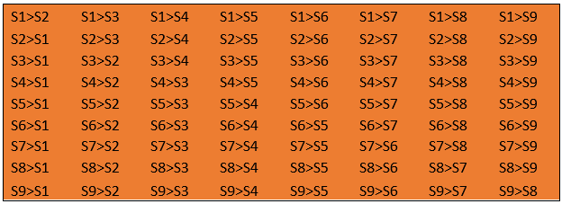
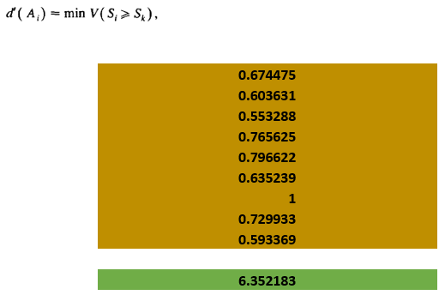
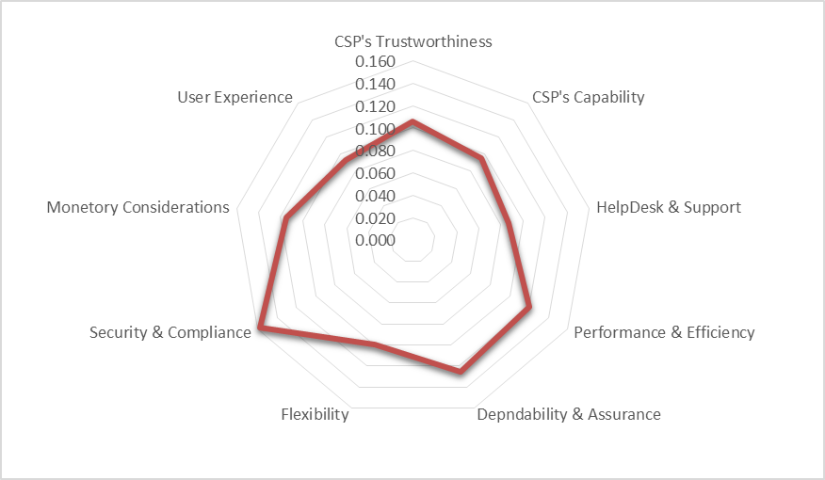
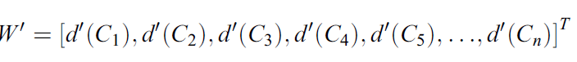
Fuzzy AHP
FAHP computations
Step. 1 Calculating the fuzzy synthetic extent
Step. 2 Degree of possibility
Step. 3 Priority weight vector calculation

Slide 9
Evaluation and Ranking
TOPSIS
WASPAS
MMOORA
Step. 1 Constructing of the decision matrix
Step. 1 Constructing of the decision matrix
Step. 1 Constructing of the decision matrix
Step. 2 Normalizing the decision matrix
Step. 2 Normalizing the decision matrix
Step. 2 Ratio system for normalization
Step. 3 Construction of weighted normalized decision matrix
Step. 3 Determining first and second criteria of optimality
Step. 3 computing summarization ratios

Slide 10
Evaluation and Ranking
TOPSIS
WASPAS
MMOORA
Step. 4 Determining the positive and negative ideal reference points
Step. 4 joint generalized criterion of optimality
Step. 4 Determining the ref. point of MOORA
Step. 5 Determining the distance of each alternative from +ive and -ive IRFs
Step. 5 evaluating service alternatives
Step. full multiplicative form
Where
Step. 5
Step. 5 evaluating service alternatives
Individual rankings are either summarized
or theory of dominance is used for
consolidated ranking

Slide 11
Generalization of evaluation criteria identified from literature
Concrete evaluation Factors | Generalization
Ease of use, operability , understandability, UI, Accessibility | Usability
Prevention of vendor lock in, Portability, Interoperability, cross platform support | Contractual Flexibility & Lock-in prevention
Usefulness, Appropriateness, Effectiveness | Functional suitability
Resource utilization, capacity, Speed Service Specific Performance characteristics: CPU performance (integer, floating), upload speed, download speed, Memory Performance, Sequential, Random Read/Write Disk Performance and consistency, avg seek time, transfer rate etc. | Performance
Resilience, Fault tolerance, recoverability, Reliability | Reliability
Adaptability, Extensibility, Flexibility | Changeability
Consistency, persistency, Performance stability, Performance variability (Opposite) | Service Stability
Presence (years) in market, experience | CSP’s Maturity
Data Isolation, data Protection at rest & in transit, Encryption, Data Redundancy, Data Retention, Data Integrity, Privacy, Data Ownership | Data protection, privacy and Control
Identity & Access Management, Application & interface Security | Authentication, Authorization and Access Control
Proactive Threat & Vulnerability Management, Disaster recovery Plans, Back Up & Data recovery, Business Continuity & operation resilience | Risk Management & Operational resilience
Flexible Pricing, Cost Transparency, Flexible Service Offerings | Flexible & Transparent Pricing Structure
Auditability, Third Part Audits, Accountability, Transparency & visibility | Transparency & Accountability
Customer Support, Technical Support, Help Desk, Customer service response speed, Responsiveness, 24/7 help | Customer Service Quality & Responsiveness
Exit plan, reversibility, exit provisions, Exclusivity | Exit Provisions
Free Trial, Try before Buy, test of a solution | Trialbility

Slide 13
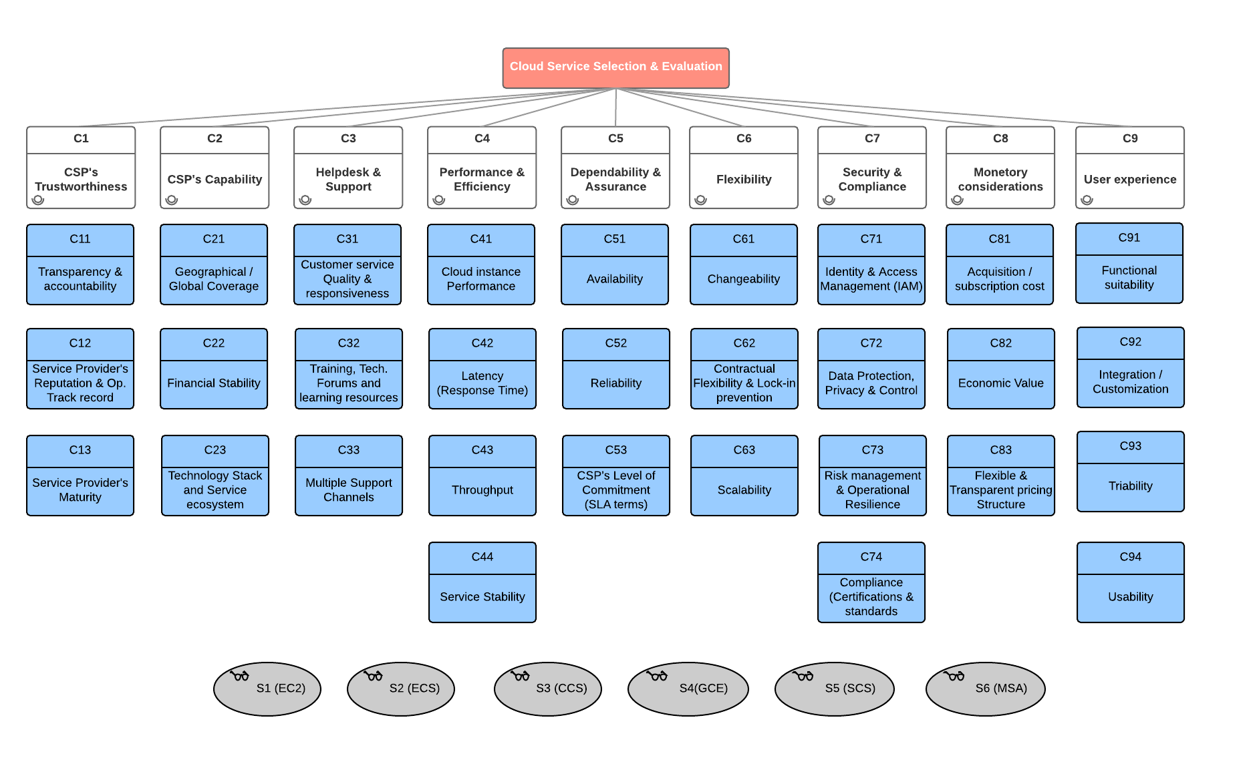

Slide 14
Priority weights of the main criteria

Slide 15
Main Criteria | Main Criteria weights | Sub-criteria | Prority weight vector | Final Sub-criteria weights
CSP's Trustworthiness | 0.1062 | C11 | 0.4002 | 0.0425
 |  | C12 | 0.4964 | 0.0527
 |  | C13 | 0.1034 | 0.0110
CSP's Capability | 0.0950 | C21 | 0.5237 | 0.0498
 |  | C22 | 0.2723 | 0.0259
 |  | C23 | 0.2040 | 0.0194
Helpdesk & Support | 0.0871 | C31 | 0.3831 | 0.0334
 |  | C32 | 0.3354 | 0.0292
 |  | C33 | 0.2815 | 0.0245
Performance & Efficiency | 0.1205 | C41 | 0.3412 | 0.0411
 |  | C42 | 0.2338 | 0.0282
 |  | C43 | 0.1581 | 0.0191
 |  | C44 | 0.2670 | 0.0322
Dependability & Assurance | 0.1254 | C51 | 0.4103 | 0.0515
 |  | C52 | 0.3319 | 0.0416
 |  | C53 | 0.2579 | 0.0323
Flexibility | 0.1000 | C61 | 0.3043 | 0.0304
 |  | C62 | 0.4001 | 0.0400
 |  | C63 | 0.2956 | 0.0296
Security & Compliance | 0.1574 | C71 | 0.2965 | 0.0467
 |  | C72 | 0.3457 | 0.0544
 |  | C73 | 0.1370 | 0.0216
 |  | C74 | 0.2209 | 0.0348
Monetary Considerations | 0.1149 | C81 | 0.6626 | 0.0761
 |  | C82 | 0.1687 | 0.0194
 |  | C83 | 0.1687 | 0.0194
User Experience | 0.0934 | C91 | 0.1817 | 0.0170
 |  | C92 | 0.2481 | 0.0232
 |  | C93 | 0.2270 | 0.0212
 |  | C94 | 0.3432 | 0.0321
Final priority weights of main and sub-criteria (FAHP)

Slide 16
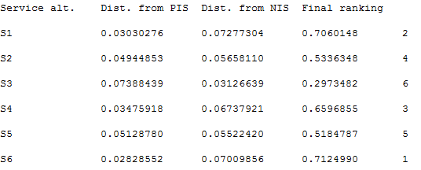
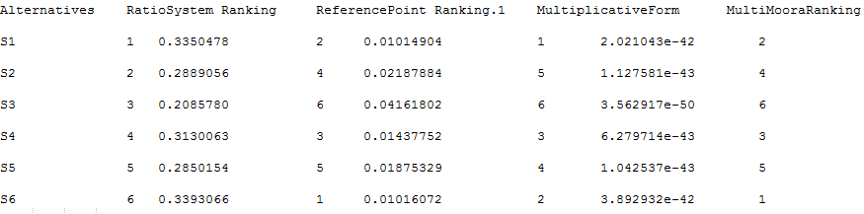
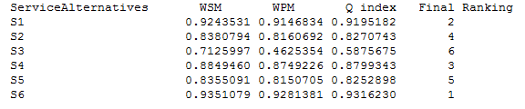
Results of service evaluation
Service ranking (TOPSIS)
Service ranking (MMOORA)
Service ranking (WASPAS)

Slide 17
Sensitivity analysis
Sensitivity analysis is conducted to verify the robustness of the ranking by each model (FAHP-TOPSIS, FAHP-MultiMOORA, FAHP-WASPAS) and further support the decision when selecting the final solution.
A sensitivity analysis pattern is devised to conduct the analysis. In this pattern all other criteria values are kept intact and values to two criteria are interchanged. Then ranking is calculated again to analyze the impact of changing criteria weights.

Slide 18
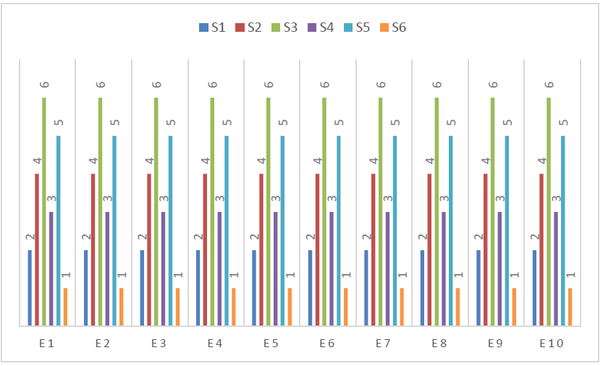
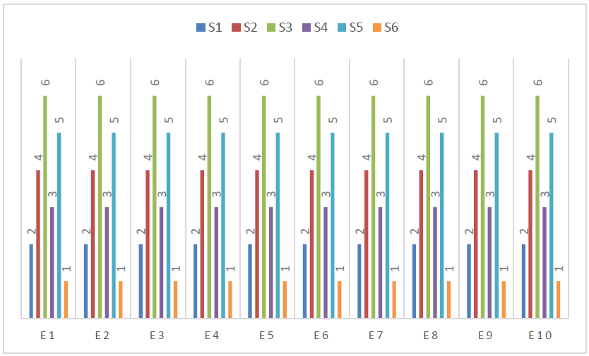
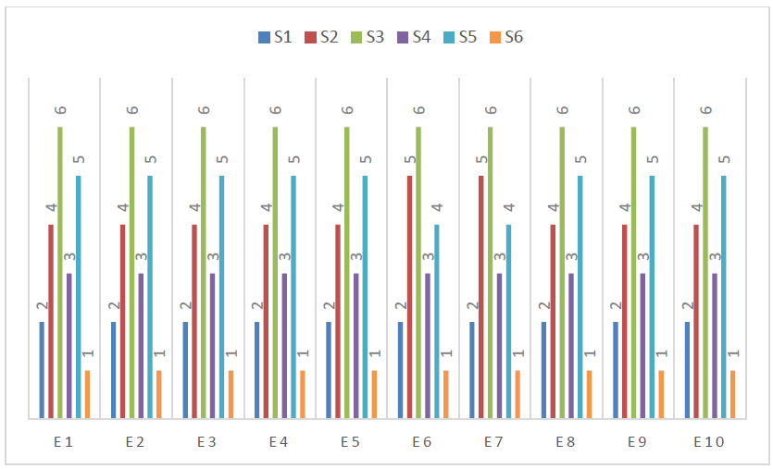
Sensitivity analysis (FAHP-TOPSIS)
Sensitivity analysis (FAHP-MMOORA)
Sensitivity analysis (FAHP-WASPAS)

Slide 19
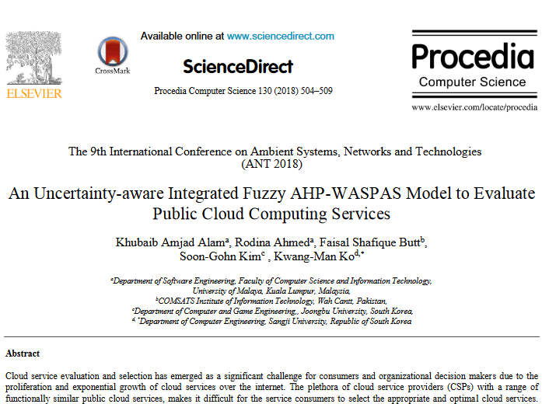
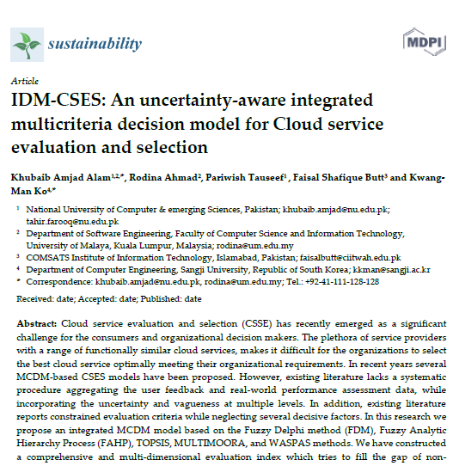
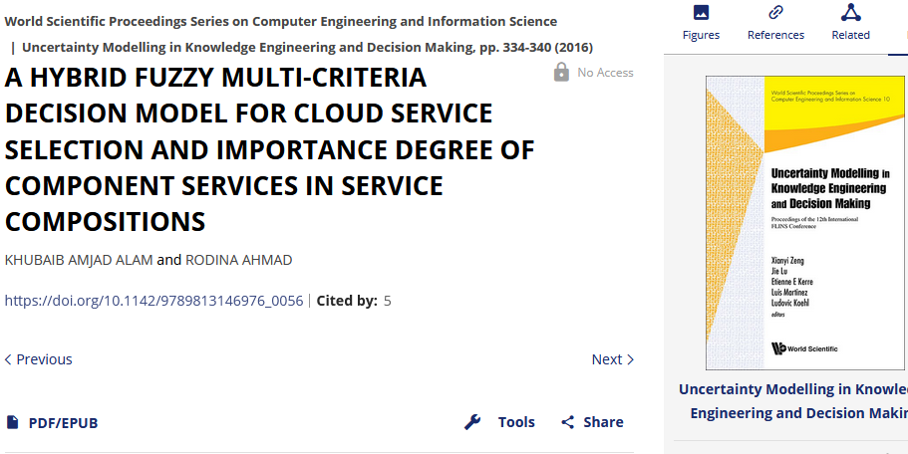

Slide 20
2. Scientific workflow scheduling (SWFS) in Federated Cloud Environments
Scientific workflow scheduling (SWFS) and task scheduling in cloud computing has recently attained considerable attention of research community.
Job scheduling is a traditional way of scheduling that handles dependency among the submitted jobs.
In contrast, SWFS aims at mapping and managing the execution of inter-dependent (Precedence constraints) tasks on shared resources for applications with high complexity.

Slide 21
Problem Statement (2/3):
Benefiting from scalable resources and virtualization technologies, federated cloud has emerged as a promising solution to process large-scale scientific applications for users in a pay-per-use manner.
However, considering the complexity of resource configuration and deployment in federated cloud, existing workflow scheduling algorithms designed for single cloud systems are not scalable to federated cloud environment.
In contrast to single cloud environments where multitude of scheduling solutions exist, SWFS solutions for federated cloud are rather scarce. None of these SWFS solutions for federated cloud have yet considered, dynamic workload distribution, energy consumption and dependability constraints.

Slide 22
Problem Statement(3/3):
However, its hard to design an optimal scheduler that satisfy multiple conflicting criteria simultaneously (Such as varying cost and execution time).
To address this issue:
There is a need to design a scalable and optimal scheduler that will effectively map workflow tasks on to available computational resources (VM) while considering the multiple conflicting criteria simultaneously.

Slide 23
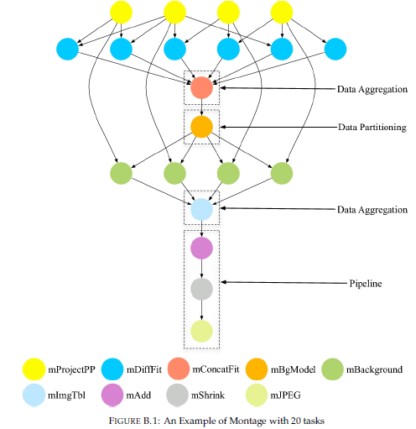

Slide 24
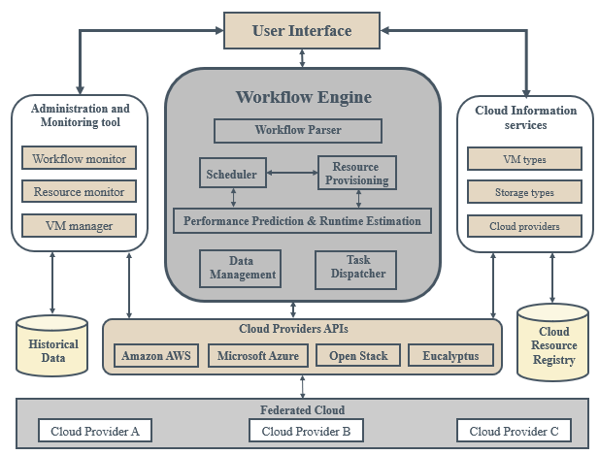
Architecture

Slide 25
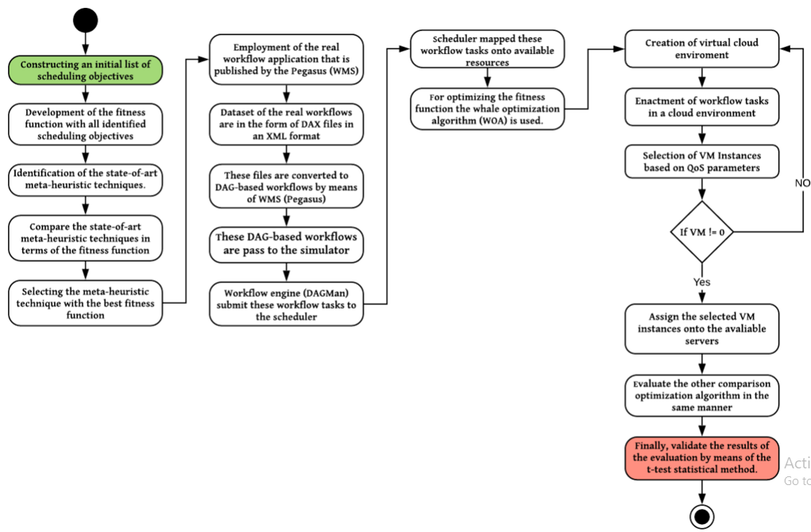
Step-wise Procedure

Slide 26
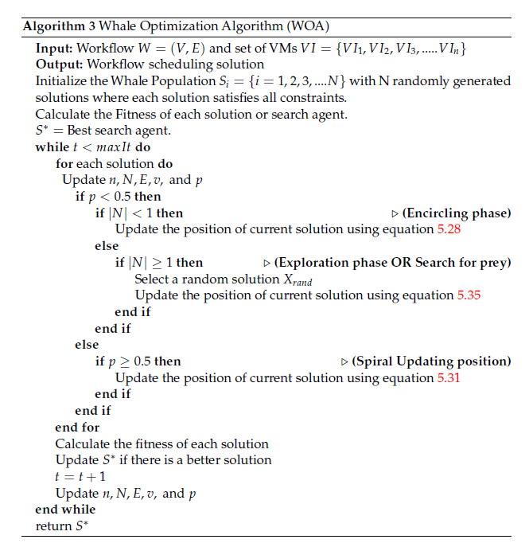


Slide 27
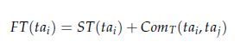
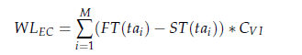
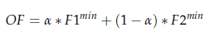
Makespan:
Execution Cost:
Objective function:

Slide 28
Experimental Evaluation:
Cloudsim
Parameter | Value
RAM (memory) | 512-2048 (MB)
Bandwidth | 1-1000 (mbps)
Number of processors | 1-4
File Size | 300-500
No. of cloudlets | 50-2000
Length of tasks (MIPS) | 500-1500
No. of iterations | 50-2000
No. of VMs | 1-10
No. of Datacenters | 1-8
Type of manager | Time_shared, space_shared
VMs Monitors | Xen

Slide 29
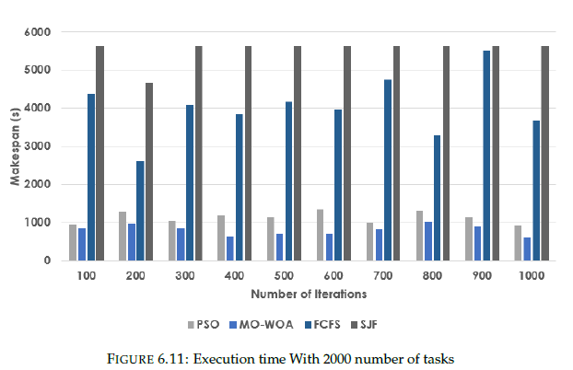
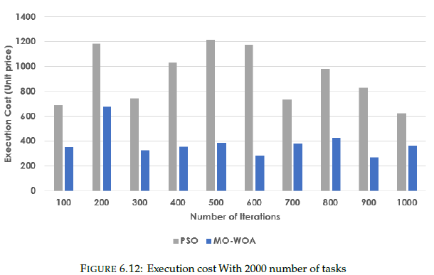

Slide 30

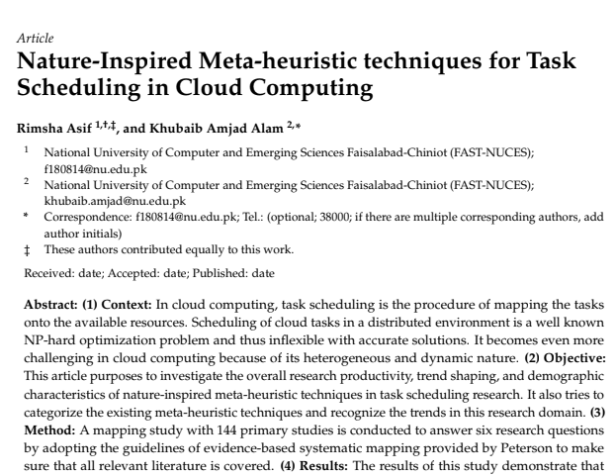
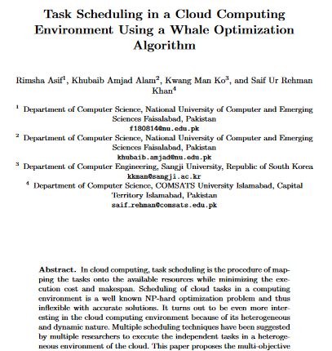

Slide 31
A Soft-Rough Set Based Approach for Handling Contextual Sparsity in Context-Aware Video Recommender Systems
CAVRS seek to improve recommendation performance by incorporating contextual features along with the conventional user-item ratings.
Selection of influencing contexts with minimal conflicts is identified as a potential research challenge.
we have proposed a novel contextual information selection process using Soft-Rough Sets.
The proposed model will select a minimal set of influencing contexts using a weights assign process by Soft-Rough sets.
Model is extensively evaluated on “LDOS-CoMoDa” dataset.
The proposed model outperforms existing solutions by identifying relevant contexts efficiently based on certainty, strength, and relevancy for effective recommendations

Slide 32
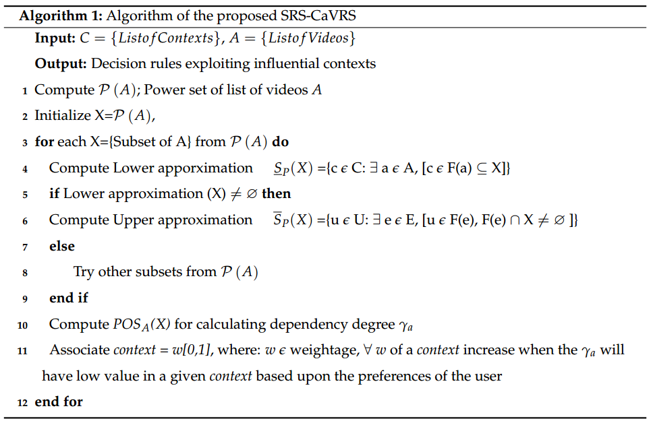
Proposed Algorithm for SRS-CaVRS

Slide 33
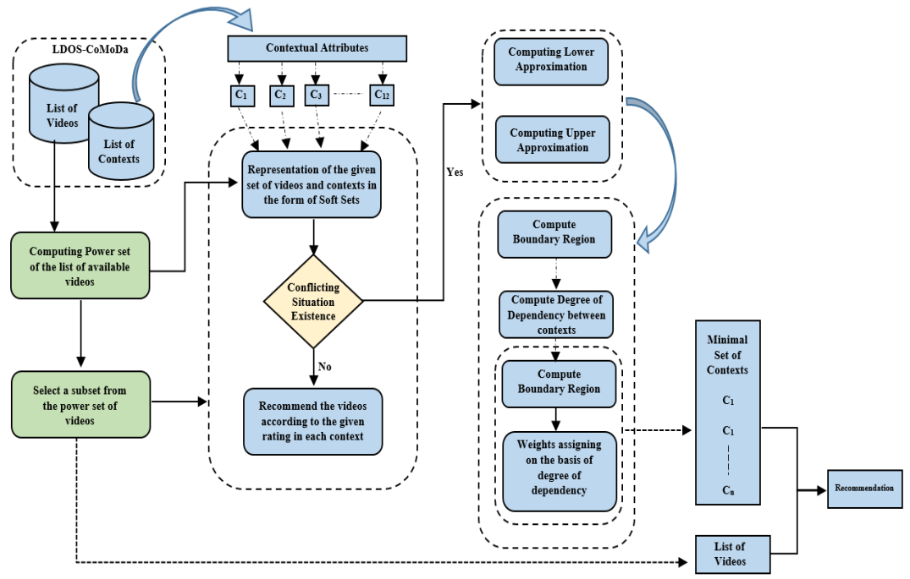
Overall Architecture of Proposed Scheme

Slide 34
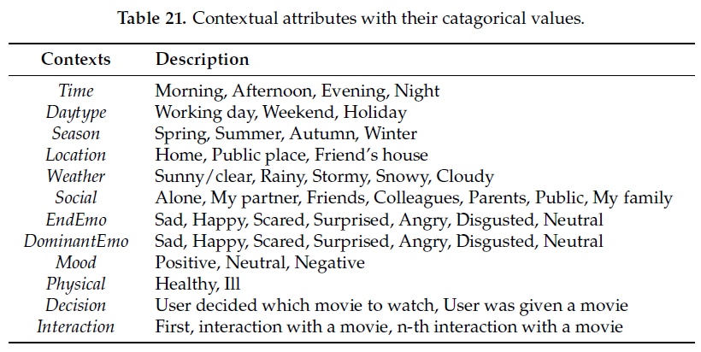

Slide 35
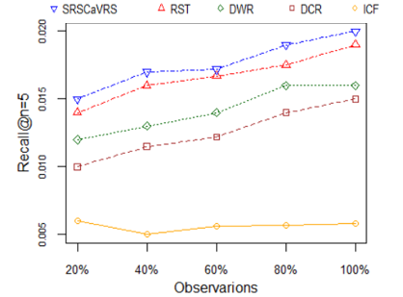
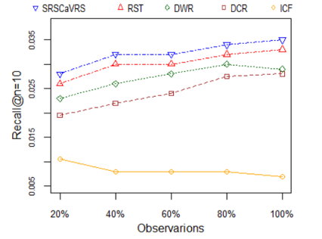
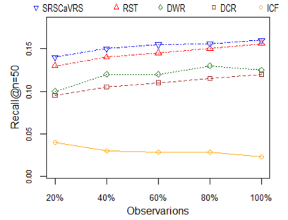
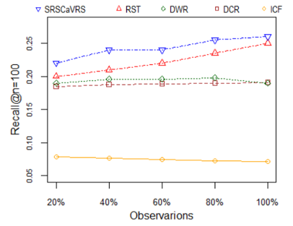
Evaluation and Results (Effectiveness using Recall)

Slide 36
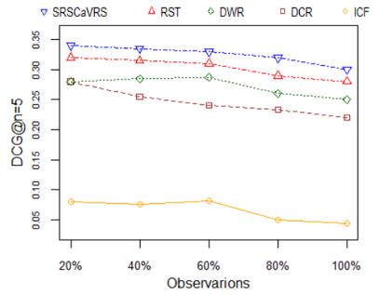
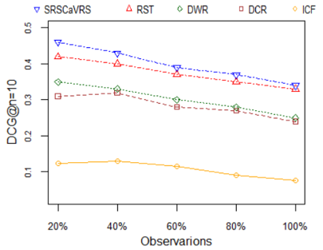
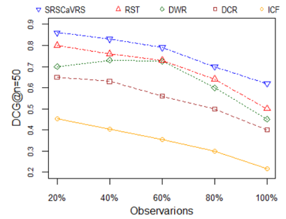
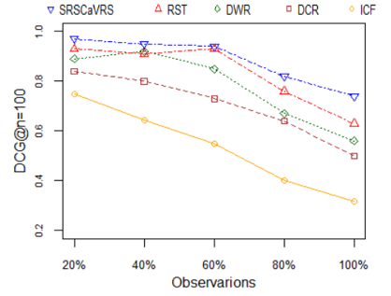
Evaluation and Results (Effectiveness using DCG)

Slide 37

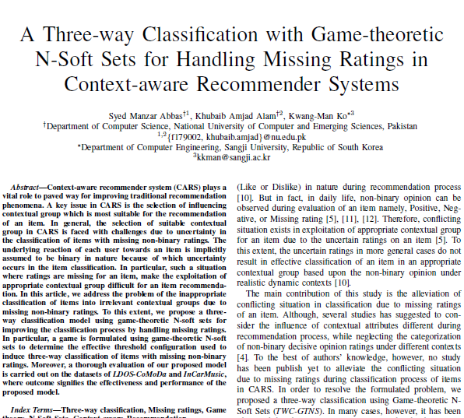
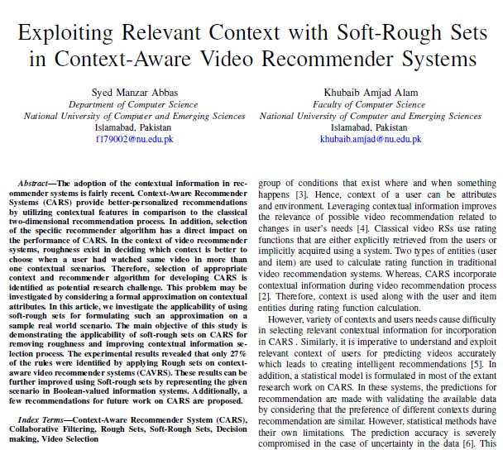
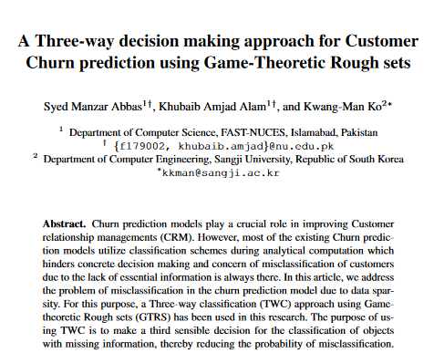
Extensions and relevant publications:

Slide 38
Evidence-based Software Engineering
A peculiar focus of SEOR is on:
Systematic Literature Reviews
Systematic Mapping Studies
Tertiary Analysis
Bibliometric/Scientometric Analysis
12 secondary studies published. Several in pipeline

Slide 39
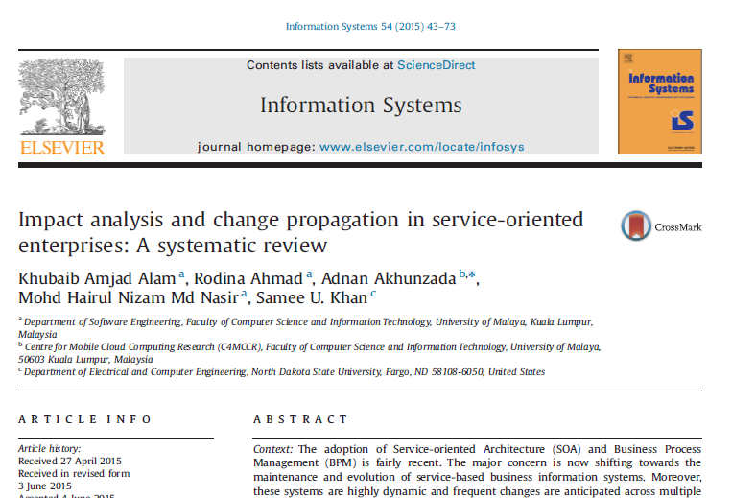



Slide 40
Thank you!

